Slide 1
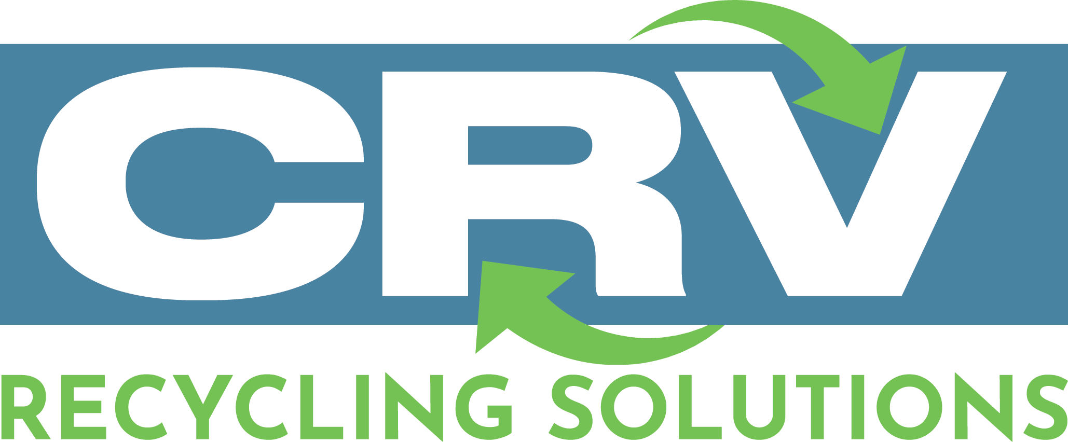
Mandatory Integrated Recycling Zones (MIRZ)
Modernizing California’s CRV Recycling System
California CRV Modernization Proposal
Mandatory Integrated Recycling Zones (MIRZ)
A long-term structural fix for the California Redemption Value system

Slide 2
1. The Problem
• No built‑in space for CRV redemption at supermarkets
• Cities slow or inconsistent with permits
• Landlords resist recycling operations
• Operators face unstable and temporary locations
• Consumers cannot easily redeem CRV

Slide 3
2. MIRZ – Structural Solution
• Require CRV Recycling Zones in building plans
• Indoor room (300 sq ft) or outdoor pad (32×20 ft)
• Supermarket must host operator, RVMs, or redeem in‑store
• Standardized designs + fast‑track permits
• Permanent infrastructure for redemption

Slide 4
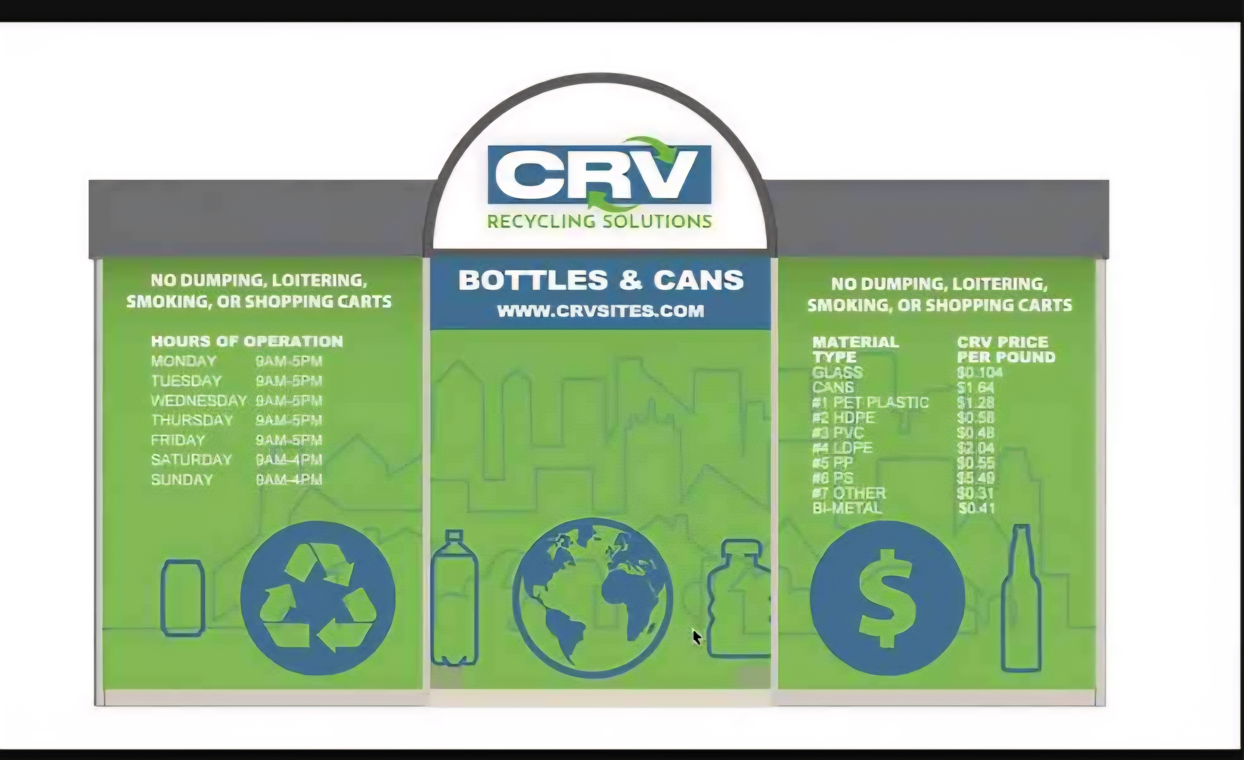
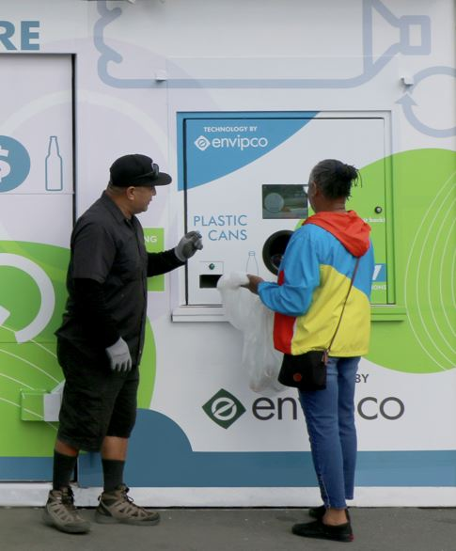
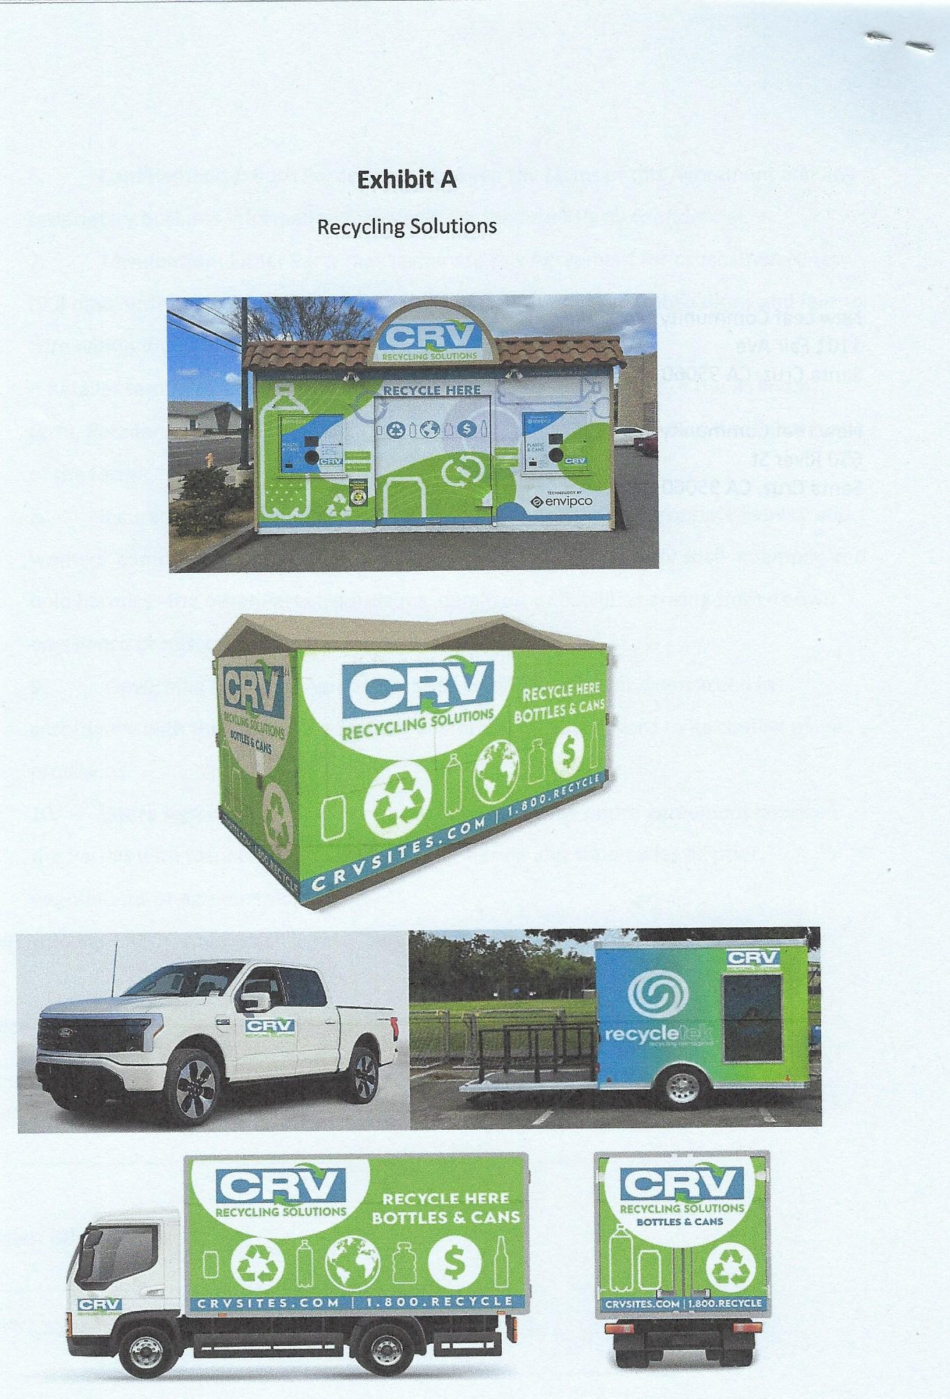
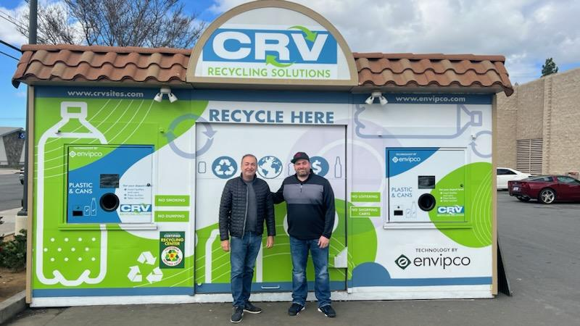
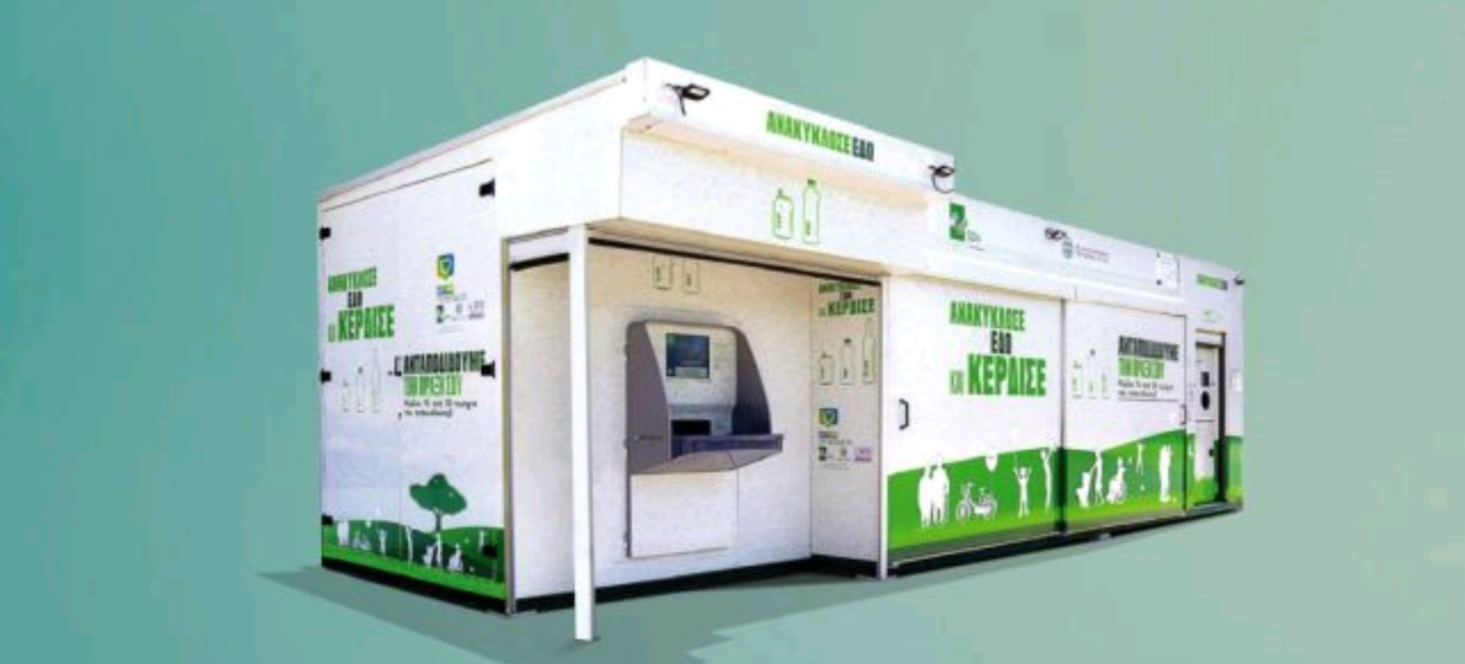
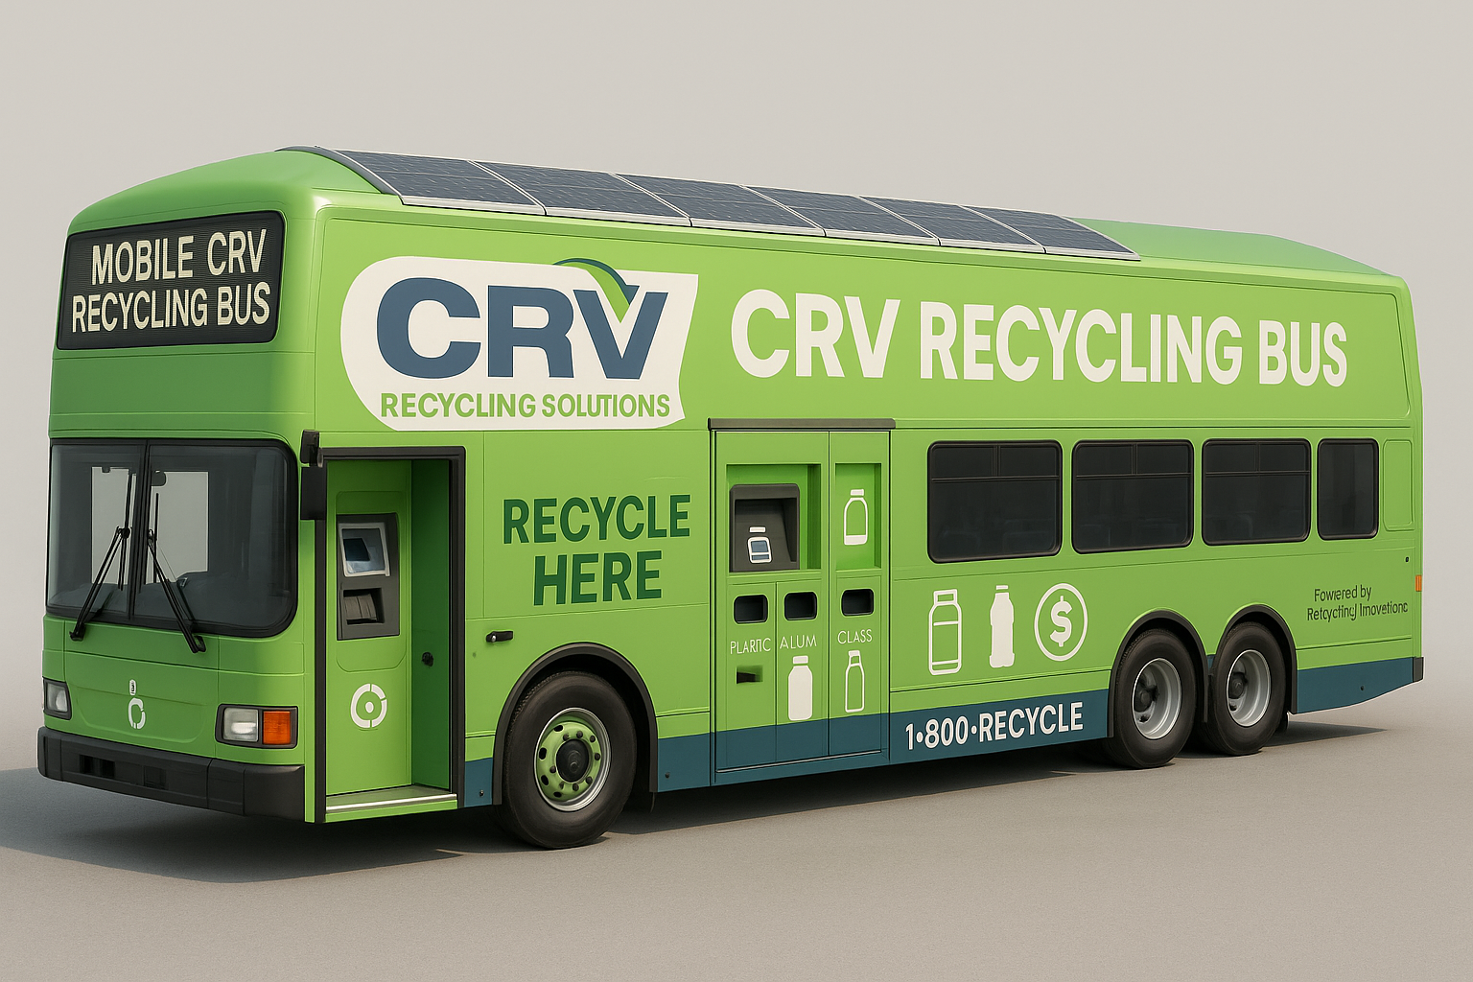
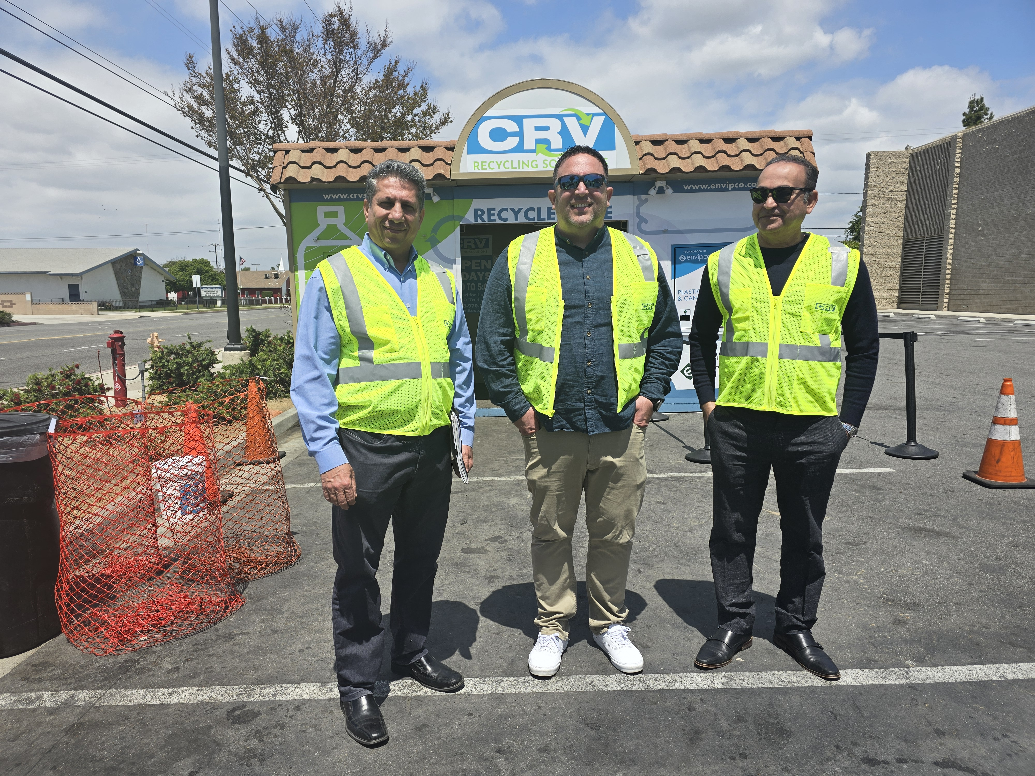
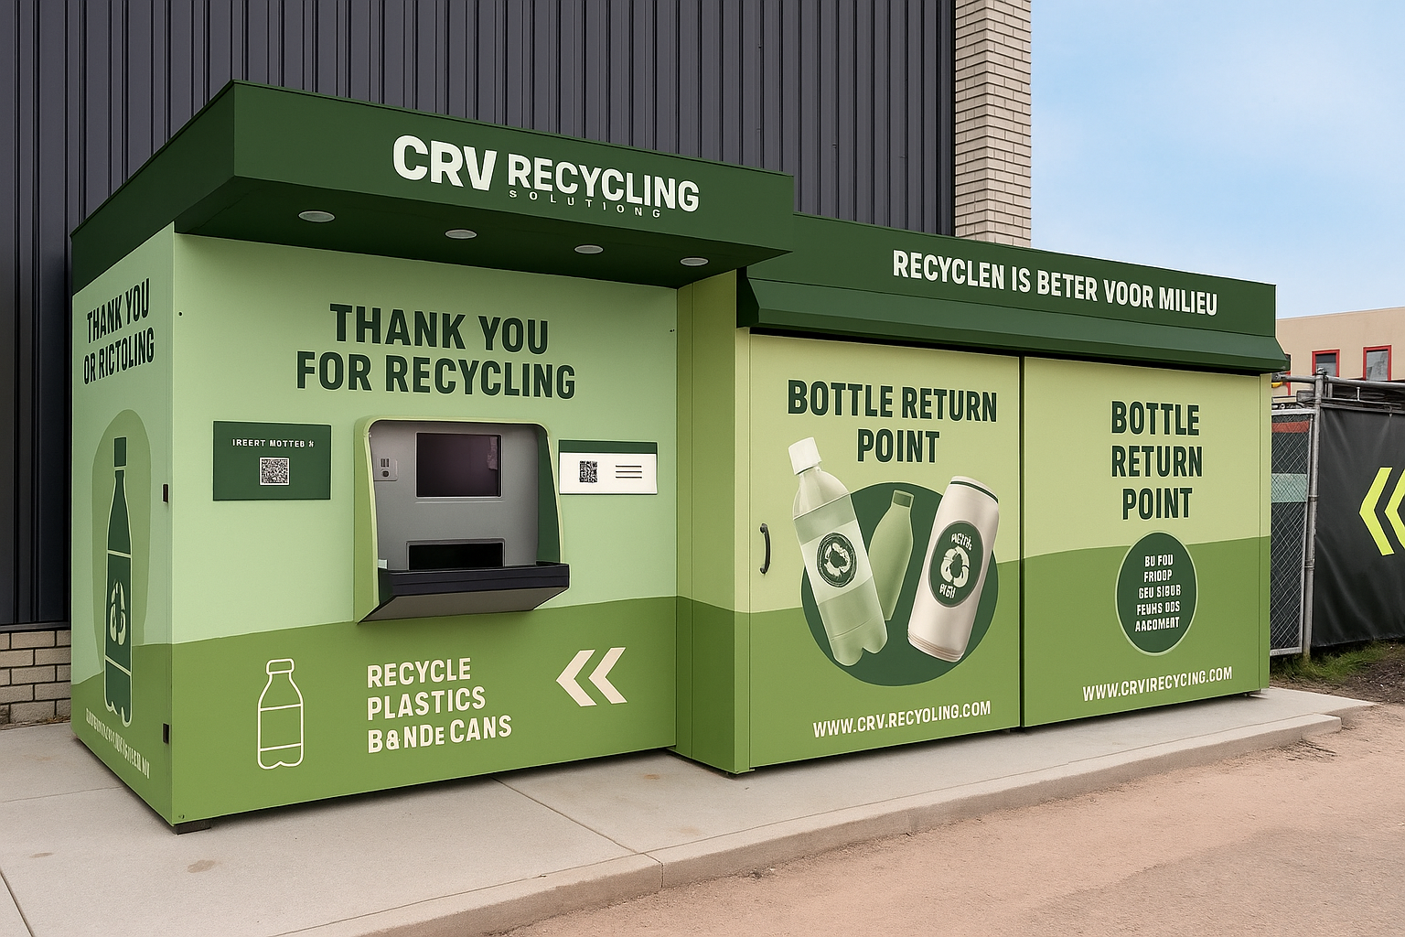
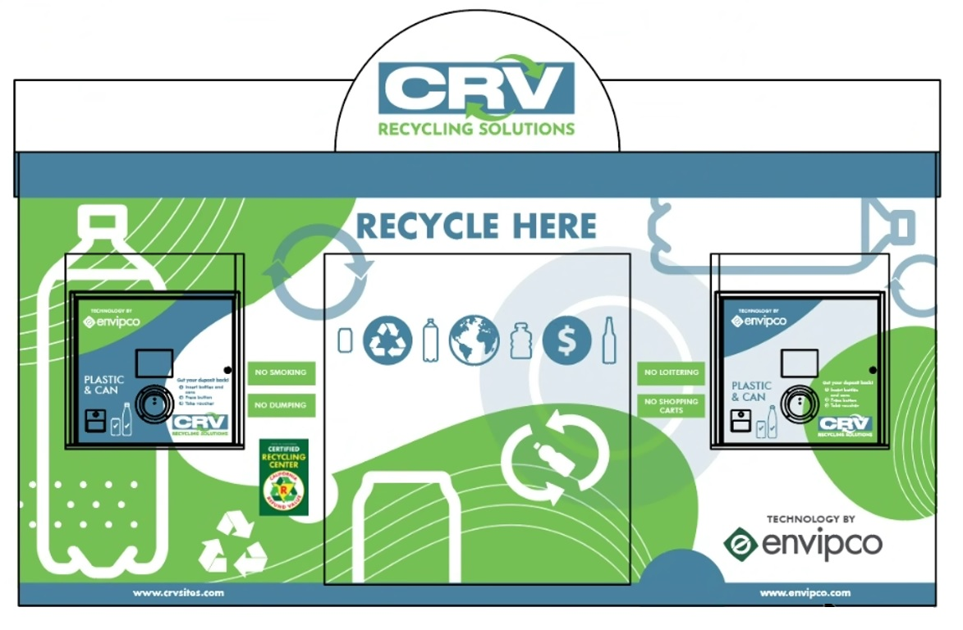

Slide 5
3. Incentives for All Stakeholders
Supermarkets:
• Monthly hosting credits
• Reduced fees & faster permits
• Infrastructure grants
• Liability protections
Landlords:
• Property tax credit
• Infrastructure grants
• Liability protections
Cities:
• 45‑day permit deadline
• Grant priority
• Better environmental compliance

Slide 6
4. Benefits of MIRZ
• Higher recycling rates statewide
• Cleaner communities & less landfill waste
• Stable, predictable redemption sites
• Stronger operator network & compliance
• Universal access for all Californians

Slide 7
5. Our Company’s Role in MIRZ
CRV Recycling Solutions / Recycling Innovations:
• Leading operator providing compliant CRV services
• Experts in mobile units, kiosks, bag‑drop & full‑service RCs
• Ready to operate MIRZ‑designated supermarket zones
• Supports statewide modernization & improved access

Slide 8
6. CalRecycle Q&A – Discussion Points
• How MIRZ aligns with existing SB38 / SB 1013 / SB 156 goals SB 353
• Integration with mobile units, RVMs, digital systems
• Permit path improvement for cities & counties
• Infrastructure funding opportunities
• Enforcement consistency & retailer cooperation

